Slide 1
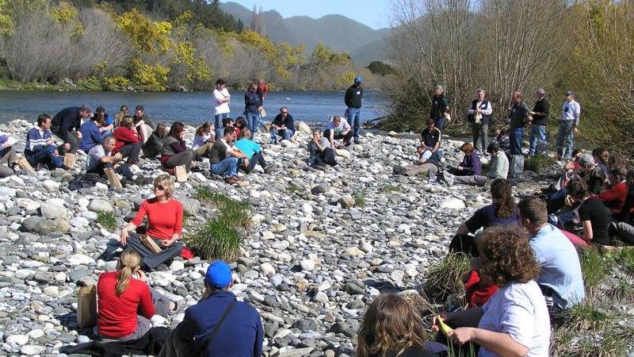

Designing and facilitating for environmental sustainability
Bridging stakeholder groups, knowledge systems and scales
Will Allen, Marina Apgar, and Margaret Kilvington
Notes:
Kia ora tatou,
I’m Will Allen – I link up with Kate and ……. [others] through the Sustainable Seas Participatory Processes work (which Dan is talking about next). But in this presentation I will share some of our thoughts on the facilitation and process design of collaborative or participatory initiatives.

Slide 2
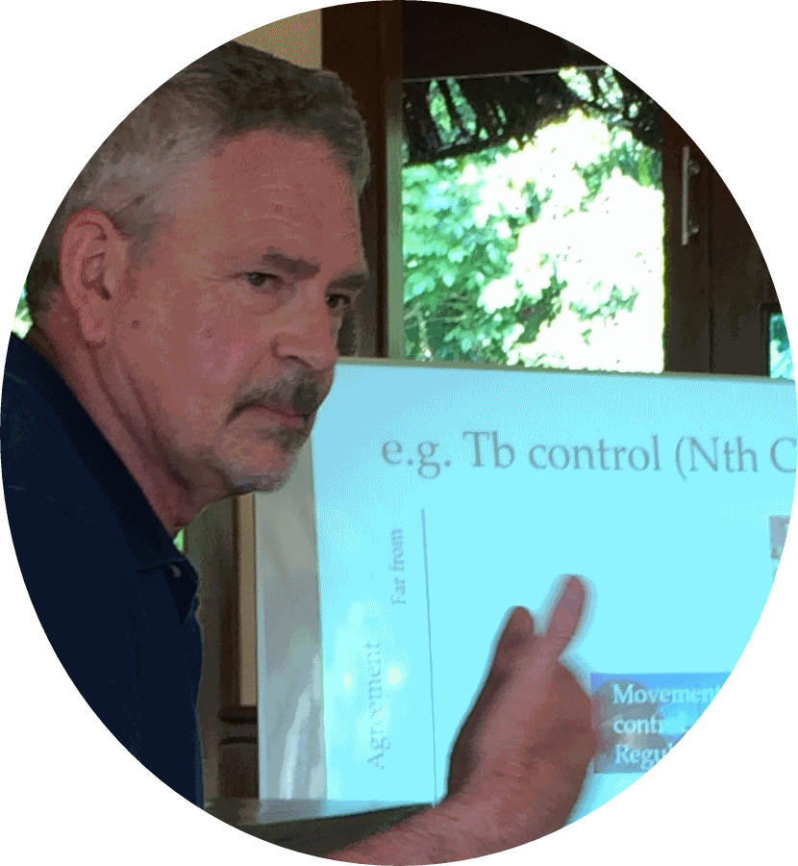
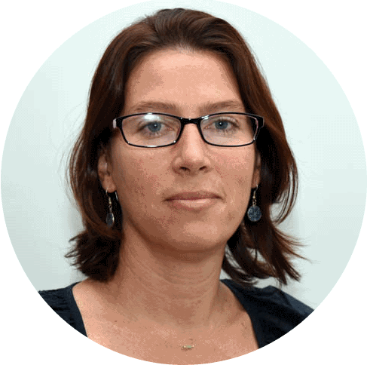
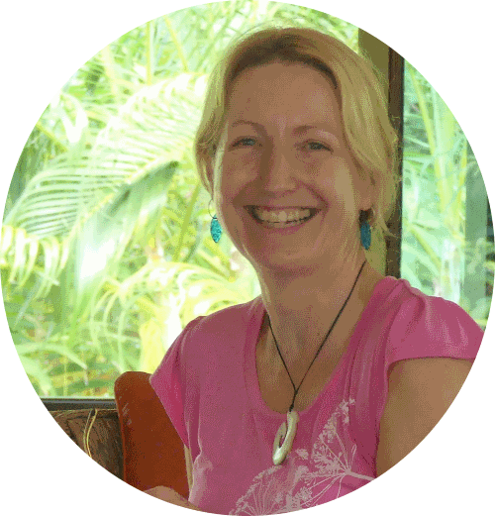
As co-authors we all work in this area … and look to share our reflections
Dr Will Allen
Dr Marina Apgar
Dr Margaret Kilvington
Learning for Sustainability
Christchurch, NZ
Institute of Development Studies
Brighton, UK
Independent Social Research, Evaluation & Facilitation
Christchurch, NZ
“Our work is change-oriented, and mostly undertaken within a broad participatory action research methodology. We are usually involved in programmes as critical friends – often bringing particular skills around participatory ‘design’, ‘facilitation’ and ‘evaluation’.”
Notes:
My colleague Margaret Kilvington is based in Christchurch, and Marina Apgar works in the Institute of Development Studies (U o Sussex, Brighton). Our work is change-oriented, mostly undertaken within a broad participatory action research methodology. We are usually intimately involved in programs as critical friends – often bringing particular skills around participatory design, facilitation and evaluation.

Slide 3
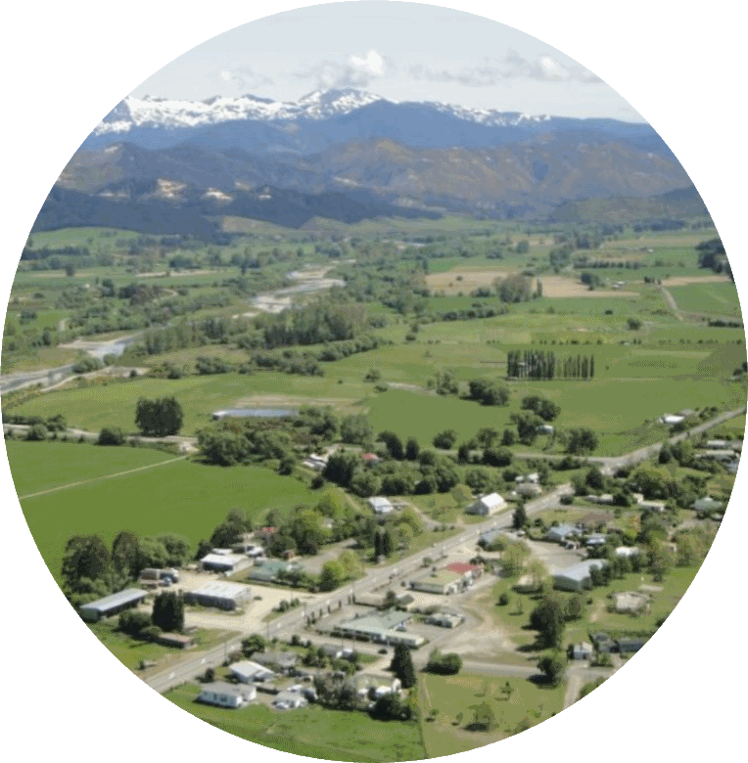
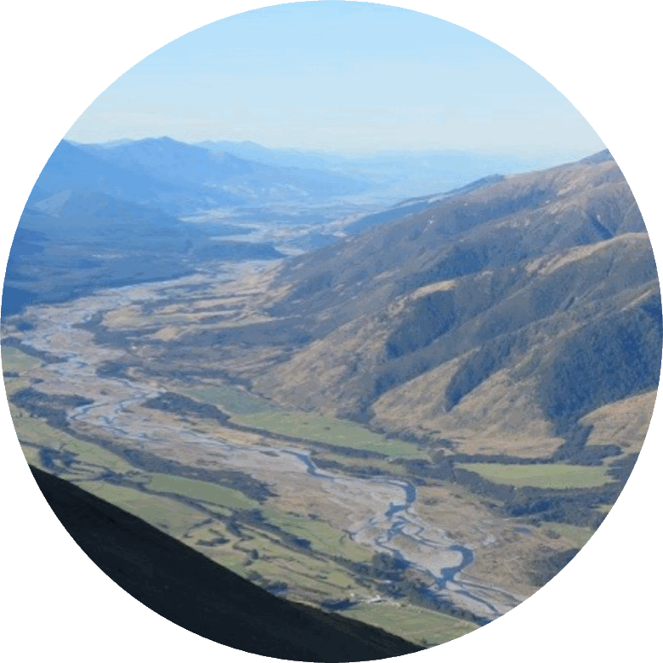
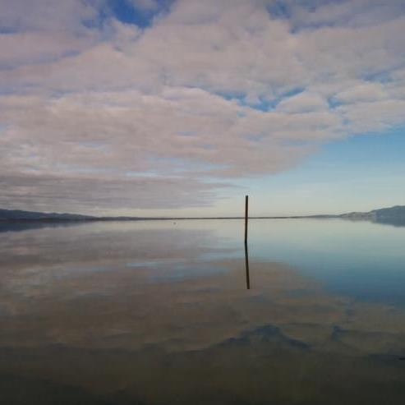
Ki uta ki tai: From the mountains to the sea
Reflecting on a range of natural resource management research projects emphasizing collaboration
Focus on freshwater policy and management
GWRC
Whaitua process design
2017
… and others
VOW
Participatory water management
2012
Sustainable Seas
Participatory Processes
2016-2019
CGIAR
Aquatic Agricultural Systems (AAS)
2012-2016
Public engagement – Risk based landuse planning
2013-2018
ICM-Motueka
2000-2011
Tapawera
2012-2014
Wairau Valley
2014-2017
Ruamahanga Whaitua
Source: Tasman District Council
Source: Nelson Lakes Motels
Wheel of Water (Phase 1 & 2)
Notes:
So we are using this as an opportunity to reflect on lessons around design and facilitation from a number of programmes we have worked in – but particularly setting our messages today in the context of freshwater policy and management. The ICM-Motueka was a 10 year multi-stakeholder, multi-institutional collaborative research programme looking at integrated catchment management in the Motueka catchment. It embodied the sense of “ki uta ki tai” – from the ridge-tops at the head of the catchment out to Tasman Bay. The Wheel of Water programme was a 6-year research programme looking at collaborative decision making for setting freshwater quality and quantity limits in New Zealand.

Slide 4
Key points for today
How do we design and facilitate collaborative processes that help us to constructively address complex natural resource management (NRM) problems
Identifying a range of key interactions and processes
- making the geography of collaboration visible
1
2
Designing collaborative processes for change
– that include and integrate key interactions and processes
Changing roles for researchers
– as facilitators and participant-observers
3
Notes:
How to design and facilitate more participatory processes is becoming increasingly important. So we want to address 3 related points today.
We need to start by appreciating the range of key interactions and processes involved in collaborative NRM decision making – making the geography of collaboration more visible.
Given that more holistic view of collaboration – how do we work with these elements to “design” (often multi-year) integrated processes.
How – as action researchers do we manage our roles in this context.

Slide 5
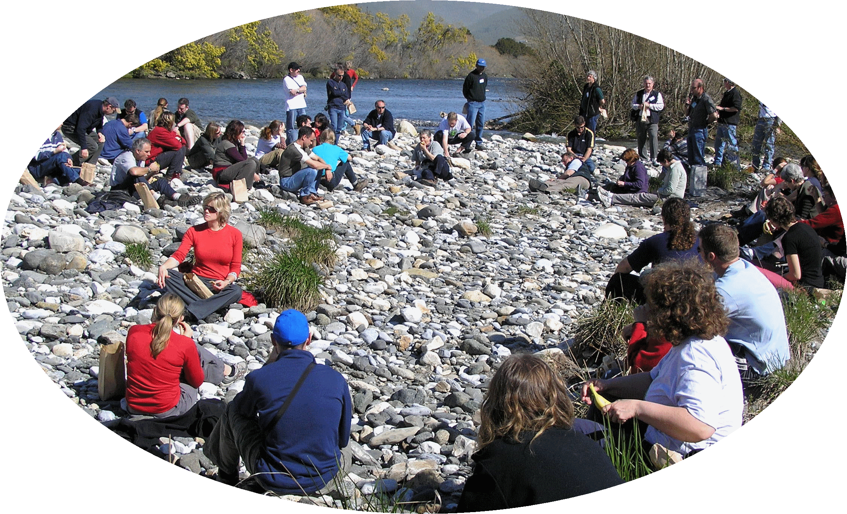
Identifying a range of key interactions and processes
- making the geography of collaboration visible
Who’s there - who’s talking (and to whom) – power and politics in action
What’s happening (and when): how is the conversation being structured - both in terms of process and content
Notes:
Point 1: Identifying a range of key interactions and processes:
Interactions - Who’s there - who’s talking (and to whom) – power and politics in action
Processes - What’s happening (and when): how is the conversation being structured - both in terms of process and content

Slide 6
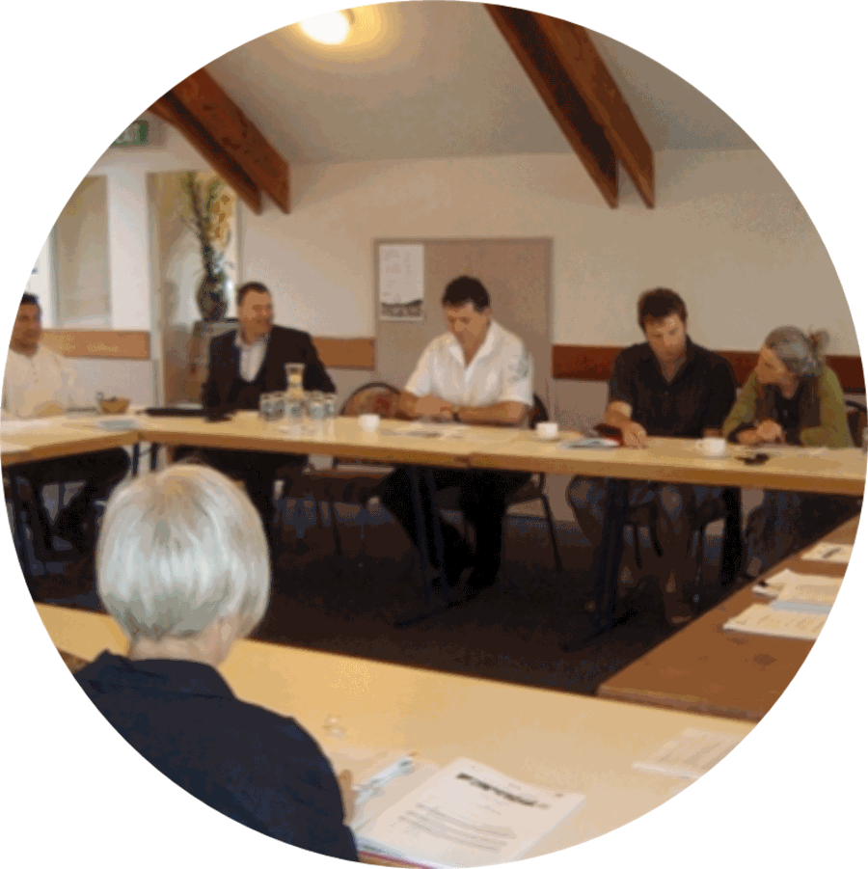
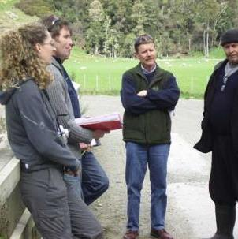
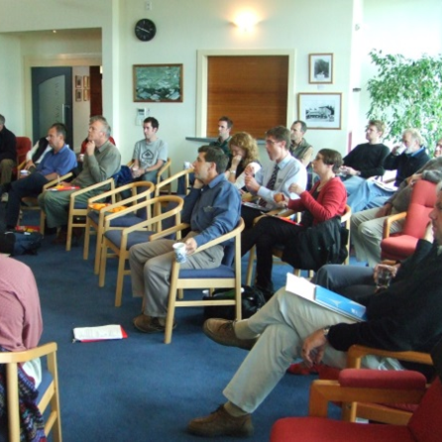
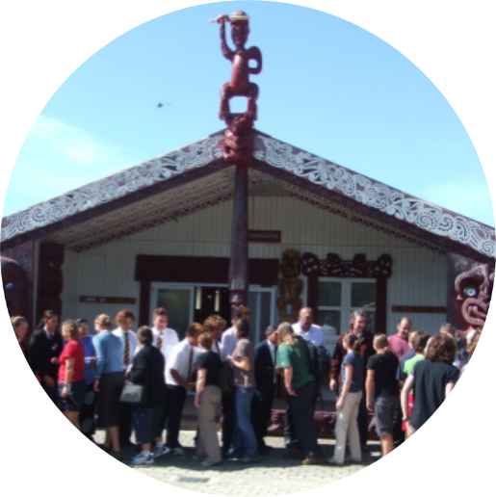
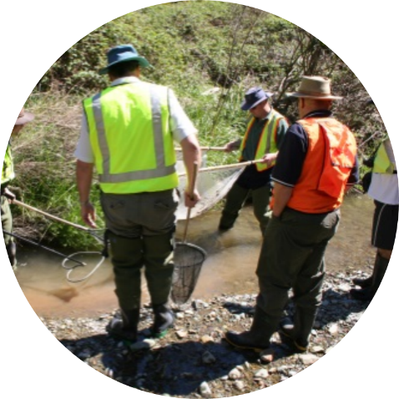
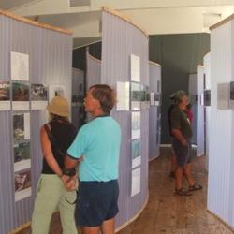
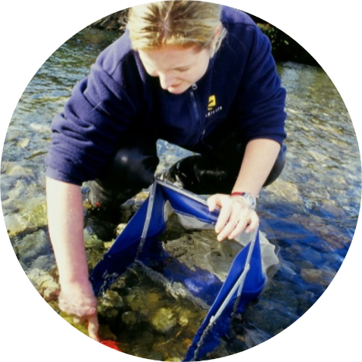
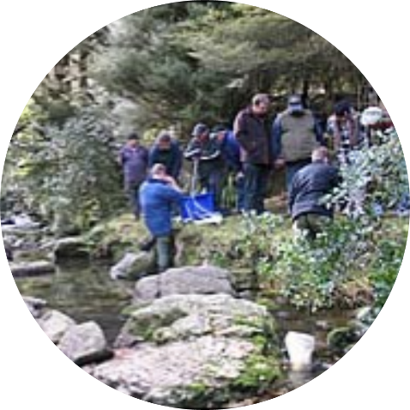
Making collaboration visible – who’s in the room
It’s common to refer to a collaborative initiative as happening in a single group – usually via formal events.
“It’s the … ‘Zone’ or ‘FLAG’ or ‘Whaitua’ …. committee - isn’t it? They meet monthly. ”
Note: These photos not of any one process and indicative only
Notes:
It’s easy to refer to a collaborative initiative as happening in a single group – usually via formal events. So, in terms of the current rounds of freshwater limit setting ….. if you’re in Canterbury it’s the … ‘Zone committee’ or it’s the ‘FLAG committee’ in Tasman, or in Wairarapa and Wellington it will be a ‘Whaitua committee’. And these committee’s do represent the focal point through which these freshwater quality and quantity limits are being developed in the first instance. But ……. [next slide] ….

Slide 7
Making collaboration visible – who’s impacting the room
We need to see collaboration as involving multiple conversations and negotiations
and … informal conversations are just as important
Note: These photos not of any one process and indicative only
Notes:
… but in our projects we see that these processes are very inclusive of a number of other conversations that are happening around the issue ….. Conversations involving iwi, farmers, scientists, and other sector and community groups. Which is, of course, what we do want to happen. And those conversations find their way back into the committee process through any number of formal - or more circuitous - routes. And even for the committee – the informal conversations that members may be involved in between regular meetings can be just as important – if not more – than the formal once a month round the table.

Slide 8
Making collaboration visible - what’s really happening:
Are we managing all the different elements in an collaborative process
Recruitment & engagement
Group facilitation
Capacity building
Sharing knowledge
Collaborative modelling
SOCIAL PROCESS..
Stakeholder values
Defining attributes
Agreeing desired outcomes
Scenarios
& strategic thinking
Monitoring, evaluation & learning
CONTENT..
SUPPORT..
Supporting project team – (often agency/council-based) may provide leadership and funding as well as relevant technical, policy, facilitation and engagement skills
TIME..
often months or even years
Notes:
And this work also provided us an opportunity to identify a range of different elements that need to happen within a constructive collaboration – involving social process, content and support. Social process elements include committee membership selection, group facilitation, building skills, etc. And these social processes help people work through key topic – or content – elements such as identifying community values, identifying suitable indicators or attributes and agreeing on a set of desired outcomes. In these freshwater limit setting processes Regional Councils - as the proponent - need to also resource these committees – so putting together the right support team is a critical part of the process. And, these processes need to mix and match these different elements in processes that play out over months and even for periods of 2-3 years.

Slide 9
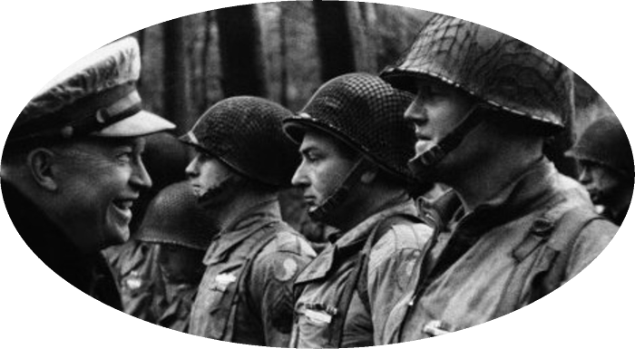
2. Designing collaborative processes for change
– that include and integrate key interactions and processes
“In preparing for battle, I have always found that plans are useless, but planning is indispensable.”
- Dwight D. Eisenhower
A “runsheet” sets out the sequential activities to guide a workshop, or event
Notes:
So with that wider sense of who and what needs to be taken into account this second section of this talk looks at how to “design” a constructive collaborative process. Just as most of you will be familiar with developing a “run sheet” for a workshop – a guide that sets out our aims, the different activities or sessions that we might plan, and what we expect to do in them …… I would invite you to see the design I am talking here as equivalent to a runsheet for a multi-year, multi-player collaborative planning initiative. And just as Eishenhower’s quote indicates – when we get into the process or workshop on the day – anything can happen – people are unpredictable – but if we have a good plan or runsheet we can adapt it …

Slide 10

A brief introduction to systemic design
Collaborative problem framing
Systems thinking
Design thinking
Co-design
- solution oriented
+
Systemic design is a recent initiative that integrates systems thinking and human-centred design, with the intention of helping cope with complex service projects.
For more information
Systemic design
Notes:
We talk about systemic design. This is a fairly recent initiative that integrates systems thinking and human-centered design. Design thinking is solution oriented – but its weakness can be that we don’t pay enough attention to look outside the box at what the problem really is. Systems thinking is mostly used to describe problems – to see them in their wider and historic sense. So linking the two via ‘systemic design’ provides us with a conscious attempt to ensure we look to collaborative problem framing as well as remaining solution oriented.

Slide 11
Systemic design – whose actions need to be planned
(e.g. in NZ freshwater collaborative planning processes)
1. Collaborative process (committee): selection/membership, relationships & process
2. Technical support:
(science, facilitation, policy) roles, relationships & actions
Develop freshwater quality and quantity limits - place–based
(Zone, Whaitua, FLAG, etc.)
3. Communication & engagement:
aims, relationships & actions for the wider community
4. Collaborative partnership
(Councils & iwi):
roles, relationships
& actions
Notes:
So thinking about the different groups in the NZ freshwater limit planning context to include in our runsheet – We clearly want a plan for the Zone or Whaitua committee – how they are selected, and how they relate and manage their process. But we also need to pay attention to how the technical support group – scientists, modellers, planners – are going to manage things, their relationships and roles. And if the aim is to take the community along on this learning journey – then we also need to plan for how comms and engagement expertise and resources will be deployed throughout the process. And, given the importance of these processes attention needs to be paid to the governance level as well.

Slide 12
Systemic design – identifying key design phases
(e.g. in NZ freshwater collaborative planning processes)
Entry and contracting
1
Understanding the System
Implement, assess and adapt
Manage collaboration and dialogue for co-design process
3
Designing for Change
2
Understanding the Choices
Important to clarify and set out ‘aims’ and ‘success factors’ for each phase
Notes:
And all of our processes - or run sheets – recognise the importance of guiding people through consecutive phases of effort – through an adaptive management cycle. Beginning at entry and contracting – getting the right people in the room. In a systems thinking approach - “Understanding the System” – identifying drivers, challenges and leverage points. The next phase looks to help people identify the implications of different choices, and then as agreement is reached on pathways forward more attention can be paid to designing pathways to move us towards our desired futures. And then – given the complex world we live in we can implement our plans, and monitor and adapt and learn as we move forward. Managing collaboration and dialog is at the centre of our thinking – and that is the way we are hearing people talking about the process – its not just a collaborative planning process – but it needs to be a collaborative management and learning process as well!

Slide 13
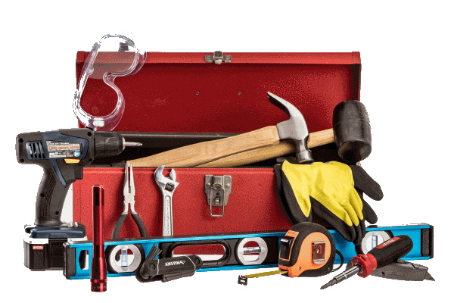
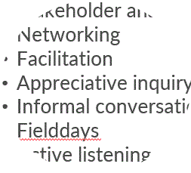
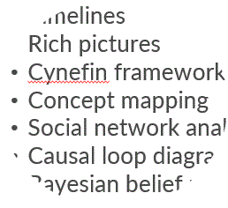
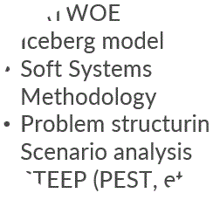
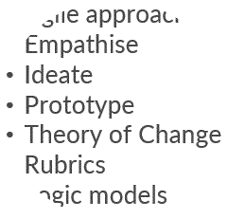
Systemic design – selecting methods and tools
(e.g. in NZ freshwater collaborative planning processes)
We need to recognise a range of tools, and select the right tool for the intended purpose
TOOLS
PHASES
Dialogue and collaboration
Understanding the system
Understanding the choices
Designing for change
There are a lot of tools to mix and match with!
Select according to aims, audience and facilitator style
For more information
Systemic design tools
Notes:
This slide reminds us that there are many tools out there – but its important to select the right tool for the intended purpose. So its important to keep in mind that these processes should always be developed with aims in mind … what is it we are trying to do, what phase of the process are we in. I have included a snapshot of different lists of tools for different phases. And then we can select the right tool – or mix of tools according to aims, audience and facilitator style.

Slide 14
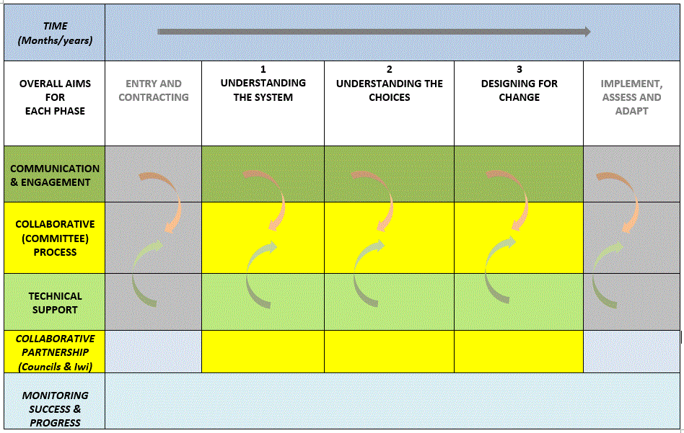
Systemic design – integrated design and ‘runsheet’
(e.g. in NZ freshwater collaborative planning processes)
Notes:
So putting all this together we get a design or a runsheet that looks something like this. The different phases we plan to work through are set out along the top … along with the likely time line that is going to be used. Then down the left of the green and yellow rows we have set out each of the key groups that we want to develop an action plan for their part of the wider process. And the important thing is that the project managers and facilitators can assess their progress for each phase across each of the key groups …… so when the process starts its important to check that all of those groups have done whatever had been planned. And say 6 or 9 months into the process when we look at understanding the system we can see whether all those groups are on the same page with that understanding of the system – down to has the community or key community members been involved in that process.

Slide 15
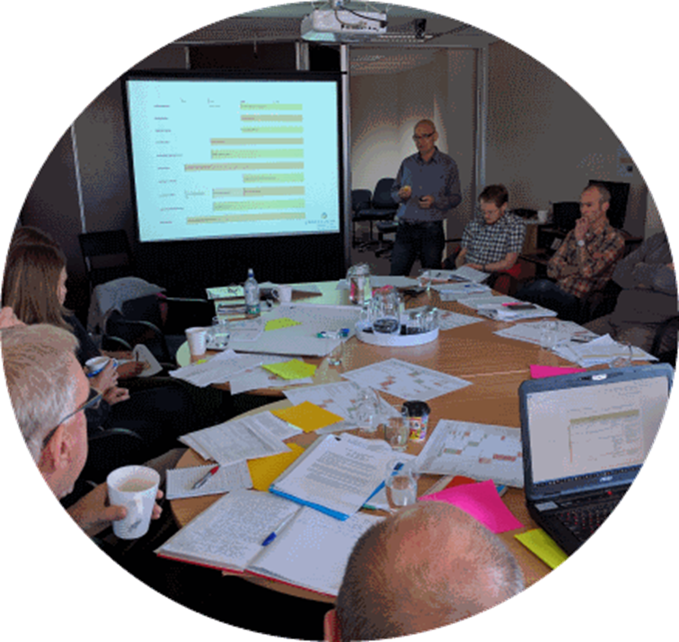
Changing roles for researchers
– as facilitators and participant-observers
Participatory action research
Modelling good practice
The truth of the work
Notes:
And finally I would like to leave you with a few reflections – quotes from other people that can use words better than I can – that highlight some of the implications and issues that we find ourselves in through this work. So specifically thinking about our role as participatory action researchers – what this means in terms of our own behaviour and practice – and the reality of working in the real world where things don’t always work, and can fairly rapidly go pear-shaped.

Slide 16
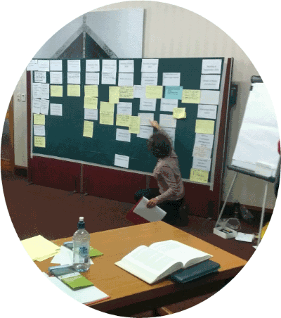
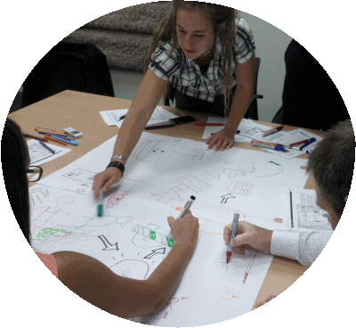
Participatory action research
“If you want to truly understand something, try to change it.”
- Kurt Lewin
Notes:
So here , Kurt Lewin, one of the founding architects of action research is reminding us that we need to get involved in change – if we really want to understand it. And in participatory action research that very much puts us in the field as participant observers – often contributing to our co-learners via our skills as facilitators, process planners or evaluators.

Slide 17
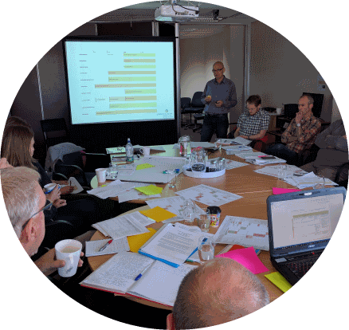
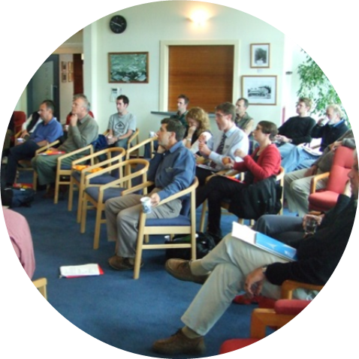
Modeling good practice
“Ultimately, as change agent what you depend on is yourself and your capacity to manage your own behaviour. Using this, you can influence processes and relationships. You can negotiate a constructive role for yourself. You can exhibit and encourage the openness and critical reflection that a change program can depend on.”
- Bob Dick
Notes:
I think I joined Bob Dick’s second AREOL – Action Research and Evaluation OnLine – course back in 1998 … and this 15 week course is still offered twice a year as a free public service. And Bob puts the change agents dilemma really well – the only things we have to work with are our processes and our ability to model good collaborative practice. {Towards the end of the ICM-Motueka programme we(as social scientists) were lamenting the fact that we would have liked to have outcomes that went beyond papers and ideas … and one of our colleagues said but you have made a big difference – “before the programme started when we as experts – geomorphologists, etc. – come into a meeting with end users we would start talking to provide our expertise. Nowadays, look at us, we come into the room and sit down and listen – and then we look to see where and how we can contribute ….. and we’ve learnt that through you guys modelling good practice at workshops over the past few years.”]

Slide 18


The truth of the work
Do not depend on the hope of results - you may have to face the fact that your work will be apparently worthless and achieve no result at all, if not perhaps results opposite to what you intended. As you get used to this idea, you start more and more to concentrate not on the results – but on the value, the rightness, the truth of the work itself.
- Thomas Merton
Notes:
And finally, we tend to come to conferences such as these – and we usually share our successes. But sometimes these initiatives don’t work, and sometimes they can really go pear-shaped!
So from our own perspective as action researchers – all we can really do is as Thomas Merton so very eloquently puts it is not to concentrate on the results – but on the value, the rightness, the truth of the work itself”.

Slide 19

For more information
Learning for Sustainability – http://learningforsustainability.net
- an online guide to resources on collaboration, co-design & adaptation
Institute of Development Studies – https://www.ids.ac.uk/publications
Engaging, learning, transforming

Slide 20

Get in Touch
Dr Will Allen (willallennz@gmail.com)
Learning for sustainability - http://learningforsustainability.net/
Dr Marina Apgar –(m.apgar@ids.ac.uk)
Institute of Development Studies - https://www.ids.ac.uk/person/marina-apgar
Dr Margaret Kilvington – (margaret.kilvington@gmail.com)
Independent Social Research, Evaluation & Facilitation - http://isref.co.nz/

